Slide 1
Module 2 Process to become accredited using the Accreditation Timeline Application

Slide 2
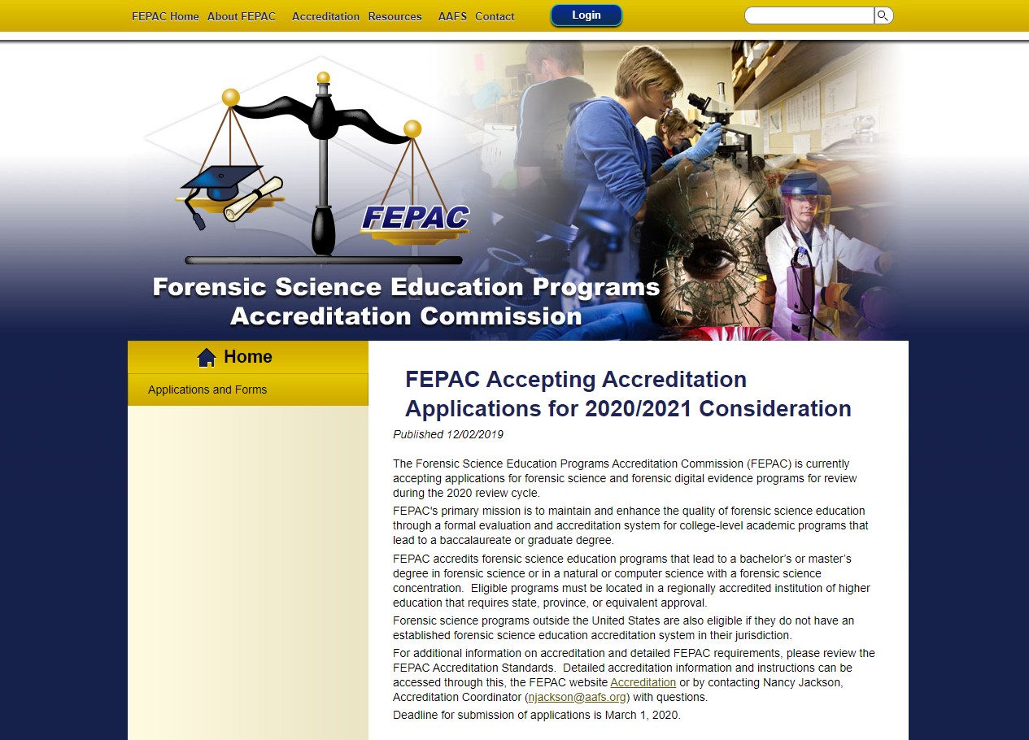
Call for submission of the Application for Accreditation
Typically* an
Electronic form
Completed on-line
$1,500 non-
Refundable fee
March 1 deadline
*2021 applications will be paper as FEPAC is transitioning its on-line service

Slide 3
Application Date of first graduates
Standard 3.1 Eligibility
Regionally accredited
Bachelor’s degree in Forensic Science, Digital Forensics or Concentration
Graduated at least two classes before application submitted

Slide 4
Application Faculty CV’s will also be included with list
Standard 3.5 Faculty
Include any faculty who teach a forensic science course designed for the program
Distributed over major disciplines of the program
Experience an education >50 full-time faculty with doctoral degree
>50% credit hours in forensic science taught by full-time

Slide 5
3-year review of program submissions
Our focus throughout today’s training will be on those standards most often in non-compliance based on a review of submissions in the past three-years.

Slide 6
Part 2 of Application and Standard 3.5 Faculty (examples from the 3-year review of applications and self-studies)
A forensic chemistry program with only chemistry faculty (Core topics not addressed in law, courtroom testimony, evidence collection, etc. from Standard 4.1)
Three full-time faculty or fewer (at risk for >50% credit hours taught by adjunct faculty from Standard 3.5)

Slide 7
Par 2 of Application and Standard 3.5 Faculty
List should not contain faculty other than those that teach forensic science courses designed for the program; however, the faculty may not be assigned to the forensic science department
To include or not to include (X) faculty who teach:
Organic Chemistry – not a forensic science course although required X
Statistics - not a forensic science course although required X
Forensic Microscopy – designed for forensic science program
Molecular Biology –biology course designed for FS program
Computer Programming – not a forensic science course although required X

Slide 8
Application Core Topics*
Standard 4.1a Forensic Science Professional Practice Topics
Courtroom Testimony
Intro Law
Q&A
Ethics
Professional Practice
Evidence Identification, Collection & Processing
*Multiple class meetings and modalities such as lectures, labs; found in
Syllabus; student mastery assessed and documented.

Slide 9
Part 3 Forensic Science Professional Practice Topics
Syllabus reviewed for topics found in objectives and/or weekly schedule

Slide 10
Application (undergraduate)
4.2. SPECIFIC EMPHASIS TRACKS CURRICULAR REQUIREMENTS
4.2.1 Criminalistics Programs with no concentrations or tracks complete
4.2.2 Biology Programs with concentration, track, or emphasis in Biology complete
4.2.3 Chemistry Programs with concentration, track, or emphasis in Chemistry complete
4.2.4 Digital Evidence Programs with concentration, track, or emphasis in Digital Evidence complete
A program with more than one concentration
should complete all sections that are appropriate.

Slide 11
Application (graduate)
5.2 CURRICULUM
Programs should complete the following section(s) that are applicable:
5.2.2 Forensic science programs with an emphasis in biology and/or chemistry.
5.2.3 Forensic science programs with an emphasis in digital evidence.

Slide 12
Curricula for Graduate and Undergraduate Programs will be examined in more detail in Module 3: Preparation of the Self-Study What does FEPAC do with the initial application?

Slide 13
Application is reviewed by Commission and makes determination for eligibility. Potential Conflict of Interest considered by Commissioners prior to vote. Program notified by May 1. If accepted, Program begins Self-Study

Slide 14
Commission selects On-site Evaluator Team (Academician and Practitioner) and Commissioner Administrative Team (Academician and Practitioner). Conflict of Interest reviewed by On-site Team, Administrative Team, and Program prior to final selection of team members.

