Slide 1
Module 3 Preparation of the Self-Study and submission (Standard 3.0) May 1 (Notification) July 15 (Submission) $2,000 fee

Slide 2
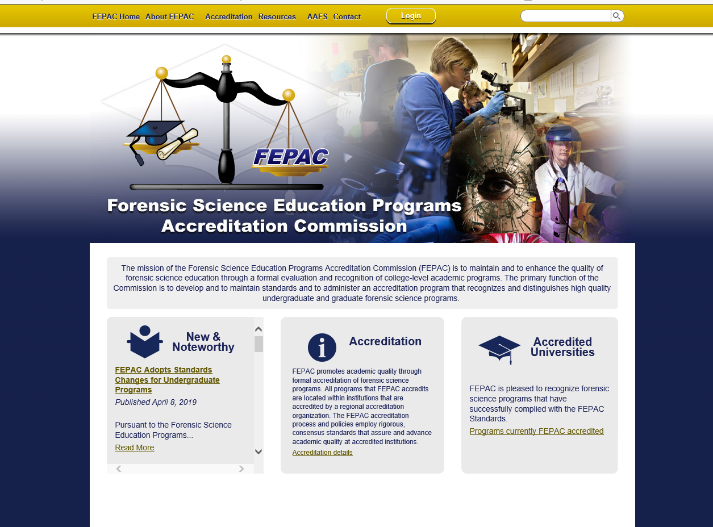
Beginning a Self-Study
*2021 self-studies will be paper as FEPAC is transitioning its on-line service

Slide 3
Self-Study
Standards
Guide to Preparing a Self-study

Slide 4
Under normal circumstances, you would begin your Self-study here, in your program account.
Since the 2021 Self-studies will be paper due to FEPAC transitioning its on-line service, the Self-study paper form will be uploaded into the “Shared Documents” folder in your program account.

Slide 5
Self-study responses for each section of the standards (All programs)
3.1 Eligibility*
3.2 Mission, goals, objectives
3.3 Planning and evaluation
3.4 Institutional support
3.5 Faculty*
3.6 Recruiting and admissions
3.7 Student support services
3.9 Distance learning
3.10 Professional involvement
3.10a Interaction FS Laboratory
3.10b Interaction FS Organization
*Application

Slide 6
Self-study standards (All programs)
3.1 Eligibility
3.2 Mission, goals, objectives
3.3 Planning and evaluation*
3.4 Institutional support
3.5 Faculty*
3.6 Recruiting and admissions
3.7 Student support services
3.8 Complaints
3.9 Distance learning
3.10 Professional involvement
3.10a Interaction FS Laboratory*
3.10b Interaction FS Organization*
*Our focus in this training will be on those standards most often in non-compliance based on a review of submissions in the past three-years.

Slide 7
3.3 Planning and evaluation – Standard (partial)
The program shall have an explicit process for:
evaluating and monitoring its overall efforts to fulfill its mission, goals, and objectives;
assessing its effectiveness in serving its various constituencies;
modifying the curriculum as necessary, based on the results of its evaluation activities;
planning to achieve its mission in the future; and,
demonstrating continuous improvement.

Slide 8
3.3 Program’s initial comments on Self-study
“The effectiveness of the program in fulfilling the mission, goals, and objectives is based on informal, anecdotal regular conversations with faculty teaching the forensic science courses
and solicited feedback from students who have completed the program.”
This is not an explicit process and it is not documented.
The Self-study does not serve as the “documentation.”
The program had no documented goals or objectives that could be measured.
The program had no process in place to review and change curriculum. The university has a process for curriculum changes, but how does the program decide that changes are necessary?

Slide 9
3.3 Planning and evaluation – Standard (partial)
The program shall conduct annual analytical self-evaluation that responds to the FEPAC standards. The documented evaluation shall include the following:
An evaluation of the success with regard to student achievement. The program must provide documentation of how collected information is used in the evaluation and development of the program to meet its stated mission, goals, and objectives. The evaluation system shall include at least the following elements:
student’s performance in a capstone experience, forensic science standardized test results, publications, or reports;
exit questionnaire or interview of graduates;
post-graduate assessment, such as job placement surveys; and,
demonstrate how collected information is used in the evaluation and development of the program to meets its stated mission, goals, and objectives.

Slide 10
3.3 Program’s initial comments on Self-study
“The program uses four main criteria to evaluate whether students who complete the program have developed a basic foundation in the forensic sciences necessary for success in a modern crime lab.” (The program goes on to describe student grades in three courses and job placement as their criteria for evaluation).
The program had no exit questionnaires
The program had no results of the student’s performance in a capstone experience, forensic science standardized test results, publications, or reports;
The program showed no demonstration of how collected information is used in the evaluation and development of the program to meets its stated mission, goals, and objectives.

Slide 11
3.3 Planning and evaluation – Standard (partial) (see also PPM 3.11.1 – Performance Disclosure)
At least one measure of student achievement must be listed on the program’s website. The measure(s) to be placed on the website are determined by the institution or program and shall be updated annually. The measures of student performance listed on the program’s website must also be listed on the annual report to FEPAC.

Slide 12
3.3 Program’s initial comments on Self-study
Detailed, current data found in Self-study and on the Program’s website

Slide 13
3.3 Program’s initial comments on Self-study
Data found in Self-study and on the Program’s website, but not updated annually.

Slide 14
3.3 Planning and evaluation – Standard (partial)
The program shall have an explicit process for demonstrating continuous improvement.
The program shall have an operational strategy that includes:
At least two significant continuous improvement initiatives; and
any remediation around potential weakness or areas needing improvement with any FEPAC Standards.
Common issues: (next slide)
Omission regarding continuous improvement process
Omission of two continuous improvement initiatives

Slide 15
FEPAC Administrative Assessment Team Initial Comments for Standard 3.
“The program response for Standard 3.3 describes in detail the evaluation of student success. The program states that the annual self-evaluation is conducted during the fall departmental faculty meeting and that a summary statement is generated to document this activity. Please submit this statement along with evidence or documentation of the program’s two continuing improvement activities. Please provide the link to the measure of student achievement and assure that it is updated annually. Current numbers are 3 years old.”

Slide 16
3.3 Planning and evaluation – Standard (partial)
Another common mistake:
Providing an area for improvement to the Program which demonstrates non-compliance with another Standard.
Program’s initial comments on Self-study
“At present, there is no process to assess the Program’s effectiveness in evaluating our efforts to meet our goals and objectives. We plan to develop an Advisory Board which will be a key part of our planning and evaluation activities.”

Slide 17
Standard 3.5 Faculty
Distributed over major disciplines of the program
Appropriately qualified by experience and education
Preferred forensic science laboratory experience
Graduate faculty shall demonstrate research activity
>50% full-time faculty with doctoral degree
>50% credit hours in forensic science taught by full-time
(Include any faculty who teach a forensic science course designed for the program)
Common issues:
Lack of involvement in forensic science organizations (Standard 3.10b)
Heavy (>50%) reliance on adjuncts (Standard 3.4 Institutional Support)
Limited forensic science experience
Too few faculty to cover the major areas of the program (topics)

Slide 18
3.5 Program’s initial comments on Self-study
“The Faculty and students in the Chemistry Club are actively involved in the local American Chemical Society meetings. The faculty have held leadership positions in the local chapter and often give guest lectures. The university hosts a local chapter dinner and lecture once every year. Many of our students attend the chapter meetings and are the largest group of students of all the colleges in the area to attend each meeting. Moreover, our students have had the opportunity to attend a Forensic Science Symposium at a near-by university in March 2015.”
Lack of involvement in forensic science organizations (Standard 3.10b)

Slide 19
Standard 3.10a Interaction with Forensic Science Laboratories
The program shall demonstrate (documented) formal interactions with at least one operational forensic science laboratory by two or more of the following:
Internships
Training provided by program to laboratory personnel
Joint research
Professional activities between the program and laboratory
Laboratory personnel serving as advisor to program

Slide 20
3.10a Program’s initial comments on Self-study
“The relationships with operational labs has been a challenge in our state. The regional crime lab does not offer tours and has limited availability of guest speakers. We have discussed internship opportunities and according to their selection criteria, only students from FEPAC-accredited forensic science programs are accepted into the program. Upon accreditation, our students can finally be considered for these internship opportunities.”
The program has no existing formal interaction with a Forensic Science Laboratory

Slide 21
Standard 3.10b Interaction with Forensic Science Organizations
The program shall demonstrate (documented) formal interactions with at least one professional forensic science organization by two or more of the following:
Faculty participate at local, state, national or international forensic science conferences.
Students attend or participate at forensic science conferences.
Service activities to or for a professional organization
Hosting an educational, training or outreach program with an external professional organization.

Slide 22
3.10b Program’s initial comments on Self-study
“The Program Director is a member of AAFS. Another faculty member is in the process of applying for AAFS membership. Interactions with forensic science organizations has been limited due to the lack of funds from the administration for conferences and workshops.” (this also points to Standard 3.4 Institutional Support)
The Program Director has never attended an AAFS meeting or had students involved. Membership alone does not constitute interaction.
No other faculty were involved in any forensic science organization.

Slide 23
Questions?

