Slide 1


Module 4
Preparation of the self Study
Standard 4.0 UNDERGraduate Program standards

Slide 2
4.0 Undergraduate Program Standards
Response in Self Study for Undergraduate Standards in all Tracks
4.1 Curriculum
4.1a Professional Practice Topics
4.1b Forensic Science Courses
4.1c Capstone
4.3 Program Director
Track Specific Standards
4.2.1 Criminalistics standards (no tracks)
4.2.2 Biology track standards
4.2.3 Chemistry track standards
4.2.4 Digital evidence standards
NOTE: Most of Standard 4 is addressed in the FEPAC Application

Slide 3
4.0 Undergraduate Program Standards
4.1 Curriculum
4.1a Professional Practice Topics*
4.1b Forensic Science Courses*
4.1c Capstone
4.2.1 Criminalistic standards (no tracks)
4.2.2 Biology track standards
4.2.3 Chemistry track standards
4.2.4 Digital evidence standards
4.3 Program Director*
*Our focus in this training will be on those standards most often in non-compliance based on a review of submissions in the past three-years

Slide 4
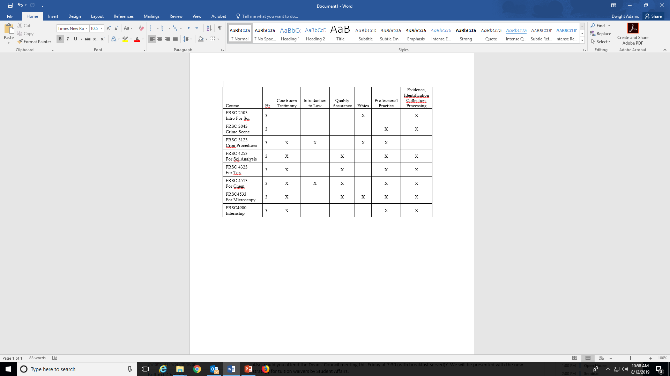
4.0 Undergraduate Program Standards
  4.1 Professional Practice Topics – a course that covers a topic must be required and the topic must be found in the syllabus.
Syllabus reviewed for topics found in objectives and/or weekly schedule

Slide 5
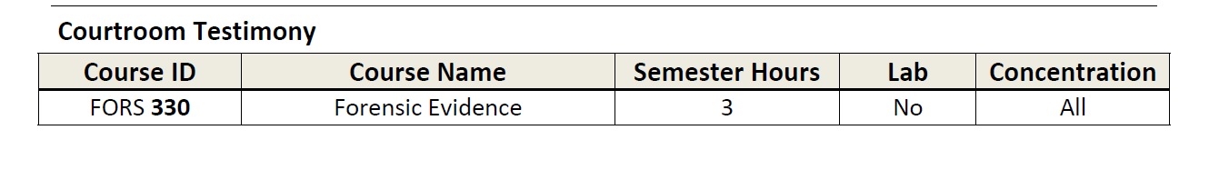
4.1a Program’s initial comments on Self Study
“This course is an advanced study of criminal law and procedure
with concentration on evidence rules, an overview of criminal trial procedures, lay and expert testimony, admissibility of evidence, pretrial discovery, typologies of evidence, constitutional rights, presumptions, relevance, privileges, hearsay, confessions, and impeachment. Competencies: Courtroom Testimony”
The course provided looks like it should meet the standard topic; however, it was an elective course, not required. It was the only course listed for the topic.

Slide 6
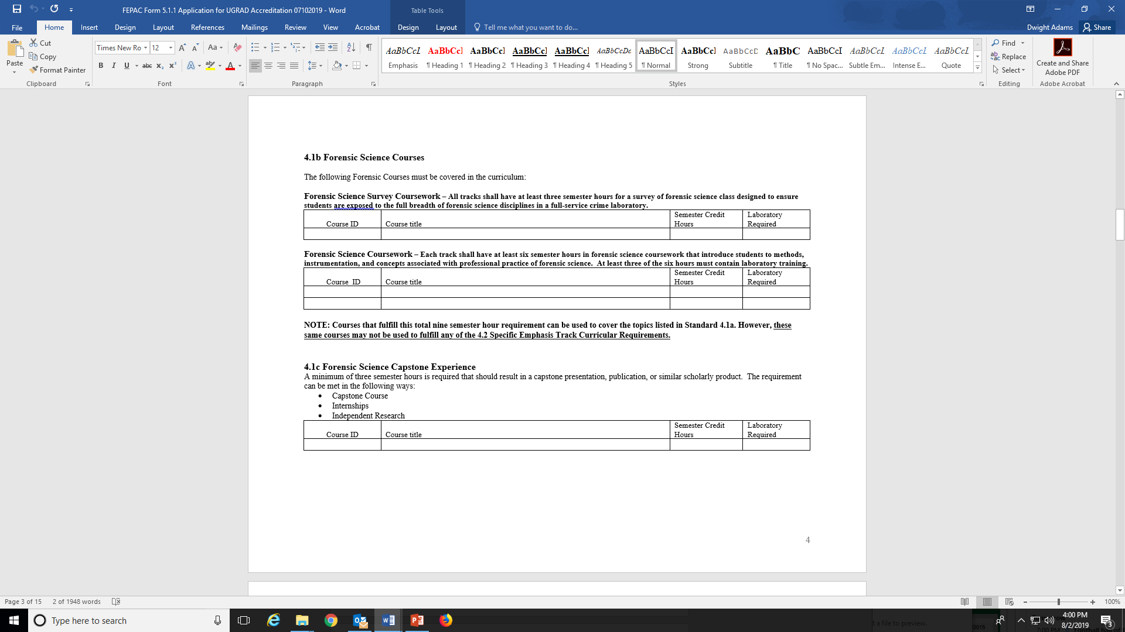
4.1b Forensic Science Courses
.
Survey Course
6 hours: methods, instrumentation, professional practice associated with forensic science
with 3 hours laboratory.

Slide 7
4.1b Forensic Science Capstone Experience
Capstone course
Internship
Individual research

Slide 8
4.1b Program’s initial comments on Self-study
“The relationships with operational labs has been a challenge in our state. We have discussed internship opportunities and according to their selection criteria, only students from FEPAC-accredited forensic science programs are accepted into the program. Upon accreditation, our students can finally be considered for these internship opportunities.”
A Capstone experience can be more than internships:
Capstone course
Internship
Individual research

Slide 9
4.1 Curriculum
4.1a Professional Practice Topics
4.1b Forensic Science Courses
4.1c Capstone
Courses listed in Topics (4.1a) may be used again in any subsequent standard to include 4.1b, 4.1c and 4.2
Courses listed in survey and forensic science courses(4.1b), and the Capstone course (4.1c), may not be used again to fulfill any requirements in 4.2

Slide 10
(Track specific Standards)
4.2.1 Criminalistic standards (no specific track)
4.2.2 Biology track standards
4.2.3 Chemistry track standards
4.2.4 Digital evidence standards
*Our focus in this training will be on those standards most often in non-compliance based on a review of submissions in the past three-years.

Slide 11
4.2.1a Natural Science Courses
Biology – two courses with co-requisite lab
Physics – two courses with co-requisite lab
Chemistry – four courses with co-requisite lab
Mathematics – calculus and statistics
4.2.1a Program’s initial comments on Self-study
“To improve the program and to fit with the FEPAC standards, we propose to change the curriculum by requiring a Biology component . . . and to require the Math elective to be statistics. Many students already take a statistics course as their math elective but we will proceed to formalize this as a requirement.”

Slide 12
4.2.1a Natural Science Courses
Biology – two courses with co-requisite lab
Physics – two courses with co-requisite lab
Chemistry – four courses with co-requisite lab*
Mathematics – calculus and statistics
*The standard requires two courses in general chemistry (minimum 7 semester hours) and two courses in organic chemistry (minimum 7 semester hours). Why “co-requisite lab?”
These requirements reflect a trend in Chemistry and Biology courses combining labs into one course (example):
CHM 2000 - Organic Chemistry I Credit Hours: 3
CHM 2001 - Organic Chemistry II Credit Hours: 3
CHM 2001L - Organic Laboratory Techniques I Credit Hours: 2

Slide 13
4.2.1b Specialized Science Courses (Criminalistics)
A minimum of 15 additional semester hours in more advanced coursework in chemistry or biology. Note: These courses shall be consistent with the degree program and shall meet the needs of students specializing in sub-disciplines of forensic science.
Non-introductory courses (usually taken after the sophomore year and not at the 100 or 1000 level)
At least two courses shall include laboratory training (7 hours)
Added depth, not breadth.
What does “consistent with the degree program” mean?
Forensic biology track (4.2.2b) – advanced chemistry or biology
Forensic chemistry track (4.2.3b) – advanced chemistry or biology
Digital evidence track (4.2.4b) – specific requirements for 12 hours covering programming and multiple topics in computer science or information systems

Slide 14
4.2.1c Forensic Science Courses (Criminalistics)
A minimum of six additional semester hours in advanced, upper-level forensic science courses that provide greater depth in forensic science beyond an introductory level.
Upper-level, non-introductory courses (usually taken after the sophomore year at a 300/3000 level)
The courses shall include laboratory training
Added depth, not breadth.
What does “greater depth” with the degree program mean?
Forensic biology track (4.2.2c) – advanced forensic biology applications
Forensic chemistry track (4.2.3c) – advanced forensic chemistry applications
Digital evidence track (4.2.4c) – specific requirements for six hours covering three topics in digital evidence

Slide 15
4.2.1c Program’s initial comments on Self-study
Course ID | Course Name | Sem Hours | Lab | Concentration
SCI 1003 | Introduction to Forensic Science | 3 | Required | All
PHY 3003 | Physical Methods in Forensic Science | 3 | Required | All
CHM 3003 | Chemical Methods in Forensic Science | 3 | Required | All
CHM 4003 | Qualitative Organic Chemistry | 3 | Required | All
Two issues stand out in this submission for the program:
SCI 1003 Introduction to Forensic Science is an introductory course, not upper-level, and it was used in Standard 4.1b to meet the survey course requirement.
CHM 4003 Qualitative Organic Chemistry would apply to 4.2.1b Specialized Science courses, but it is not a Forensic Science course and; therefore, does not meet this standard.

Slide 16
4.3 Program Director
  Full-time faculty member
  Minimum of a Master’s or professional degree appropriate for forensic science with at least 3 years relevant experience as a forensic science practitioner in a forensic science laboratory
  or
  Doctorate in an appropriate discipline and 3 years experience as an academic forensic scientist that includes appropriate educational, research, and service contributions to forensic science;
  and
  Documented management experience appropriate to the duties of the position.

Slide 17
4.3 Program Director (glossary) – full-time faculty member ultimately responsible for the leadership and implementation of the academic program.
4.3 Program’s initial comments on Self-study
Dr. Smith is the Program Director.

Slide 18
4.3 Continued Self-Study comments:
FEPAC Administrative Assessment Team Initial Comments
In a response to an earlier Standard, Mr. Jones was identified
as the Program Director. Who is the Program Director for the Program?
Program Response to Initial Comments
Mr. Jones is the Program Director and Dr. Smith is the Graduate Program Director.
On-Site Evaluation Team Assessment
The onsite team asked all of the forensic faculty and department head to describe
the roles, duties, authority and responsibilities of the Program Director and
Graduate Program Director resulting in many different, and often conflicting answers.
FEPAC Administrative Assessment Team Comments
The title Program Director has a very specific meaning for FEPAC. As such,
Mr. Jones does not meet the standard as Program Director. Moreover, it appears
from the discussion above by the on-site team, that Mr. Jones may be performing
the duties as Program Director for both the UG and Grad programs and Dr. Smith’s
title was given to meet the standard.

Slide 19
Iterative process for review of the Self-Study
Program Initial Comments
FEPAC Administrative Assessment Team Initial Comments
Program Response to Initial Comments
Program Response to Initial Comments
On-Site Evaluation Team Assessment
FEPAC Administrative Assessment Team Comments
Program Final Response

Slide 20
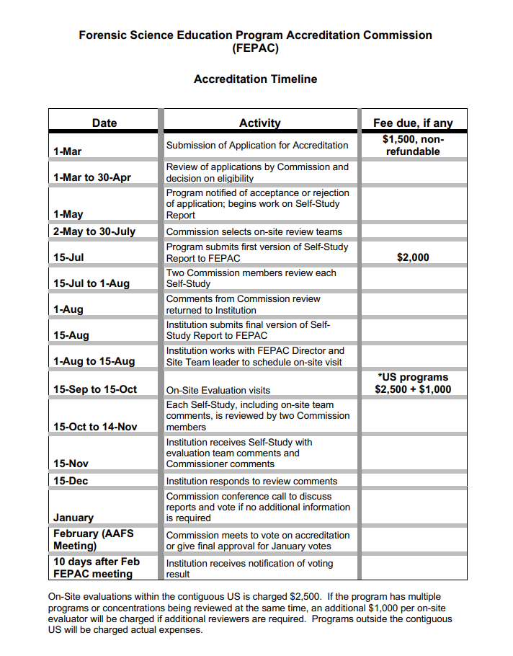
Self-Study submission and review Timeline:
July 15 Submission
Commission team review
Aug 1 Comments returned
Aug 15 Final Self-study
On-site Evaluator’s visit
Nov 15 Program receives evaluation
Dec 15 Program responds

Slide 21
Questions

