Slide 1
Module 6
Accreditation Decisions, Appeals and post-accreditation requirements

Slide 2
Module 6
Accreditation decisions
Accreditation categories
Appeal process
Annual report
Substantive changes
Post-visit survey

Slide 3
Accreditation decision timeline
Program submits Self-Study
Reviewed by Commissioner team
Program responds to review with final Self-Study
On-site evaluation
Reviewed by Commissioner team
Program responds to evaluation and Commissioner team review
Full Commission vote

Slide 4
Accreditation decisions
Decisions are posted at FEPAC website following the February AAFS/FEPAC meeting in accordance with the Council of Higher Education (CHEA) and PPM 3.13, providing details to the public about accreditation status.

Slide 5
Accreditation Categories
Accreditation - program meets all FEPAC Standards.
Conditional Accreditation - the Commission has identified some weakness(es) that must be corrected within a time frame specified. Initial accreditation or reaccreditation.
Probation - the Commission has determined that an accredited program seeking reaccreditation no longer meets one or more of the Standards and must take corrective action within a time frame specified .
Denial of Accreditation - the Commission has determined that the program does not meet the Standards. This status may be assigned only to programs seeking initial accreditation.
Revocation of Accreditation - the Commission has determined that the program does not meet the Standards. This status may be assigned only to accredited programs seeking renewal of accreditation or that have been determined, as the result of a complaint, the review of an Annual Report, or some other action, to be in noncompliance with the Standards.

Slide 6
Decision Appeal Process (4.1 PPM) - overview
A program may appeal the FEPAC decision only on the grounds that FEPAC’s decision was arbitrary, capricious, and/or not supported by the evidence available to the Commission on the date it made its decision. If a program files an appeal, any accreditation status held prior to the original FEPAC decision remains in effect until the appeal is heard and a final decision rendered.
Notice of Intent to Appeal – Letter of intent within 15 days of decision receipt with a $500 fee for the appeal.
Appeal Board – Chair of Commission selects a three-person board with experience in FEPAC accreditation, no conflicts of interest, no involvement in the original decision.
Request for Meeting – Program may request to meet with the Appeal Board.
Conduct of the Meeting – minutes are maintained and a written decision is provided to the Accreditation Coordinator within 30 days of the meeting.
Outcomes – If the original decision is upheld, the decision becomes final. The Appeal Board may remand the issue(s) back to the Commission for further consideration and final determination.
Manner of Communication – Written communication with confirmed receipt.

Slide 7
Annual Reports (3.1 PPM) - overview
A condition of continued accreditation involves submission of Annual Reports to FEPAC by December 1
$1,750 for the Annual Report fee
Annual Reports are reviewed by the Commission and may require:
A request for additional information
Conducting a special site visit
Placing the program on probation or revoking the program’s accreditation

Slide 8
Annual Reports (3.1 PPM) – Information Requested
Number of students enrolled and graduates during the year as compared to the previous year.
Changes to the Program’s (“No Change” is an appropriate response)
- Mission, Goals and Objectives*
- Curriculum
- Program Director*
- Faculty
- Institutional support or budget
- Professional involvement of faculty or interaction with a laboratory
Include any complaints received.
Provide the website of the publically disclosed data for the Program.
Address any FEPAC Standard change during the year and how the Program plans to meet the new standard.
*(Substantive Change form next slide)

Slide 9
Substantive Change Form (3.12 PPM) - overview
FEPAC requires notification within 30 days of a change and it must be listed in the following Annual Report:
Any change that may adversely affect accreditation status involving:
mission or objectives
regional accreditation status of university
courses added or delivery method that significantly departs from the Program’s previous evaluation
programs (degrees) added beyond that included in the previous evaluation
credit hour requirement for completion of the program
Program Director

Slide 10
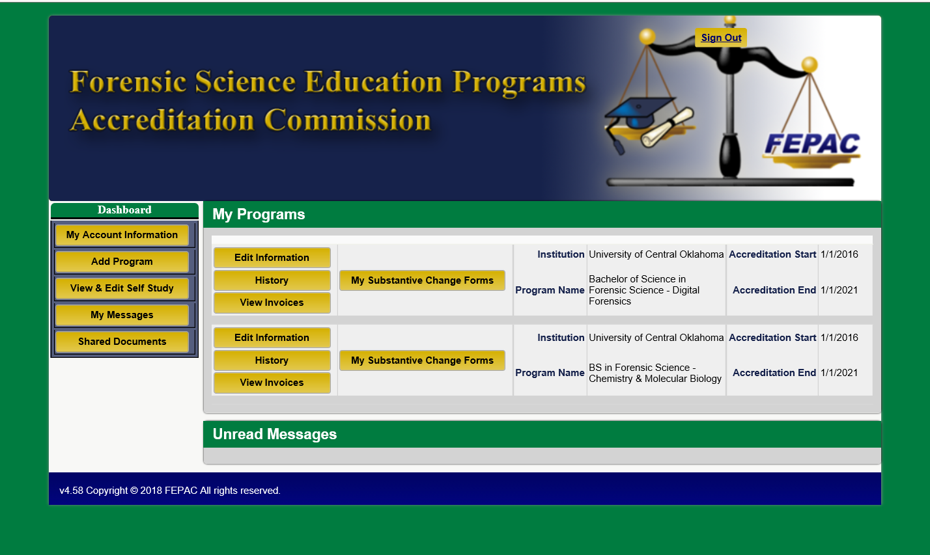
Substantive Change Form (3.12 PPM)
FEPAC Form 5.4

Slide 11
Program Post On-Site Survey

Slide 12
Thank you – questions?

