Slide 1


Essential Information to Become a FEPAC Evaluator
American academy of forensic sciences – forensic science education programs accreditation commission

Slide 2
Who may become an On-site Evaluator?
Associate, Member or Fellow of AAFS
Forensic Science educator or practitioner
Educator must be full-time faculty member or administrator of a university that offers a forensic science program.
Practitioner employed in forensic science as a scientist who is a member of ASCLD or an equivalent capacity within the profession. (May serve up to five years following retirement).
Complete today’s training session
Complete the application
Notes:
Module 1 Feb 2011
2

Slide 3
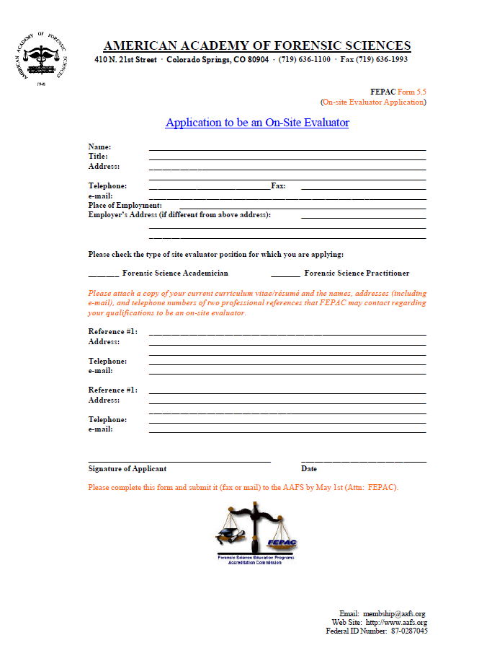
Application Form 5.5 found on the FEPAC website
Notes:
Module 1 Feb 2011
3

Slide 4
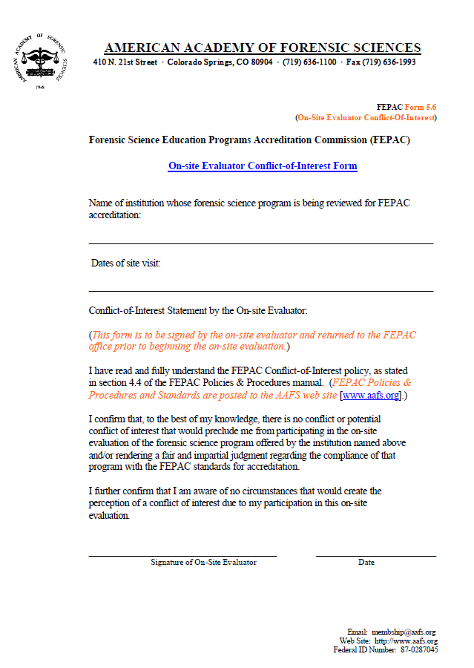
On-site Evaluator
Conflict of Interest
Form 5.6
Not employed by or graduate of the University
Program has the right to request replacement of an evaluation team member
Notes:
Module 1 Feb 2011
4

Slide 5
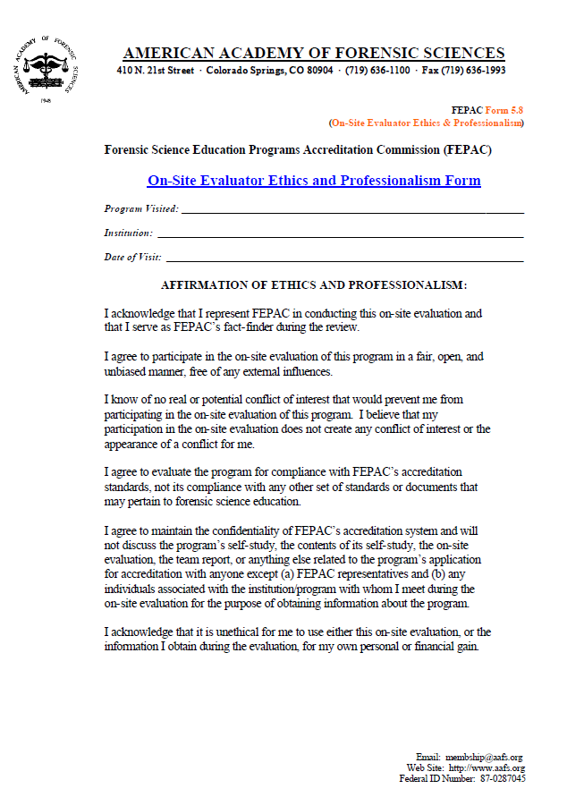
On-site Evaluator Ethics and Professionalism
Represent FEPAC
Fact-finder only
Fair, open, unbiased
Consider only FEPAC standards in your review, not your personal views
Maintain confidentiality
Use for personal gain prohibited
Notes:
Module 1 Feb 2011
5

Slide 6
On-site Evaluator
You are a guest of the Institution
Demonstrate professional behavior in speech and dress
Be sensitive to the stress the Program is under
Be objective
Fact-finding only, you are not a consultant
You do not argue, disagree or negotiate
You do not give an opinion as to what the Commission may decide
You do not provide or show a copy of your report as it is pre-decisional
Notes:
Module 1 Feb 2011
6

Slide 7
On-site Evaluator’s Responsibilities
Know and understand the FEPAC Standards
Read the Self-Study before the visit
Compare the written report to the Standards
Conduct interviews, listen and assess
Seek clarification or additional documentation if necessary
Be prepared and adhere to the schedule
Be flexible
Provide a draft comments and report to the Team Leader before you leave the Institution
Notes:
Module 1 Feb 2011
7

Slide 8
Team Leader’s Responsibilities
Know and understand the FEPAC Standards
Communicate frequently with the Program throughout the process
Eliminate any final summation surprises
Mediate any issues between team members and Program
Assimilate and submit the final report to the Commission
Copy the Accreditation Coordinator on all communication with the Program
Notes:
Module 1 Feb 2011
8

Slide 9

Become familiar with the On-Site Evaluator’s Manual
(last revised 2020)
Suggestions for meeting with the Institution’s Administration and Program
Sample reports
Checklist for required documentation from the Program
Sample on-site agenda

Slide 10
Before Site Visit
Read the Self-Study
Prepare questions for Program personnel and Administrators
Team members should meet the night before evaluation to plan and distribute assignments.

Slide 11
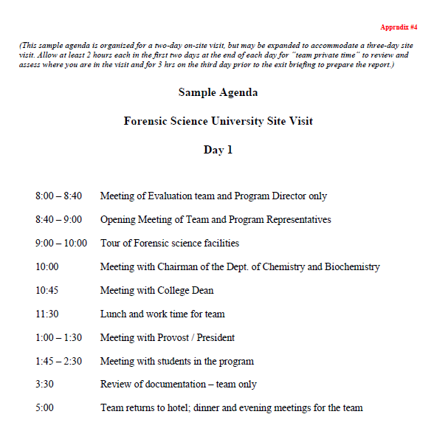
Sample Agenda Day 1
Two-day site visit
May also include:
Classroom observation
Meet or call Laboratory
Meet or call Graduates
Meet Advisory Committee

Slide 12

Sample Agenda Day 2
Two-day site visit

Slide 13
Meet with Program Director
First meeting of the evaluation
Longer than most other meetings
Pre-summation meeting at the end to avoid misperceptions
Meet with Faculty and Staff
Collectively, at first, to explain the evaluation process
Individual meetings are ideal, if practical

Slide 14
Meet with Administrators
Introduce the FEPAC Team
Briefly outline the process
Determine Administration’s support for the Program
Meeting will be brief
Discuss any concerns from Self-Study that may be impacted by the Administrators
Example: Dean Smith asked the Practitioner assessor if their agency considers FEPAC accreditation when hiring. The assessor answered “no, not important.” The answer should have been, “I can’t comment on that. I am here only to gather information.”

Slide 15
Meet with Program Graduates
Likely by phone
Quality of education received and preparedness for career
Meet with Students
Separate from faculty
Assess student perception of the Program

Slide 16
Example:
Standard 3.10a Interaction with Forensic Science Laboratories
The program shall demonstrate formal, biennial interaction with at least one operational forensic science laboratory. This interaction must be on-going and documented. This relationship must take the form of two or more of the following:
1. Student internships;
2. Training opportunities in which the program provides instruction to laboratory personnel;
3. Faculty serving on laboratory advisory committees;
4. Coordinated research initiatives between the laboratory and the academic program;
5. Professional activities coordinated between the laboratory and the academic
program;
6. Laboratory personnel serving in an advisory capacity to the academic program.

Slide 17
3.10a Review process of the Program’s initial input in the Self-Study for 3.10a – an unacceptable example
The only acceptable comment made
Notes:
Admin initial comments should not address compliance but point out areas of concern and direct on-site team
The on-site team only addressed on area of compliance while the standard requires two or more
Admin team failed to address standard adequately

Slide 18
3.10a Review process of the Program’s initial input in the Self-Study for 3.10a – an acceptable example

Slide 19
3.10a Review process of the Program’s initial input in the Self-Study for 3.10a – a common example
An example where the Administrative Team directs the on-site team to follow-up on an item in the Self-Study. This may require interviews beyond the Sample Agenda. No accreditation determination is made until the full Commission meets and reviews input from Program, Administrative Team, and On-Site Team.

Slide 20
Evaluation Report
Record specific observations and evidence related to each Standard
Address all Standards and any initial comments by the Commission’s Administrative Team
Do not indicate compliance or non-compliance
Evaluation report is pre-decisional as FEPAC Commission makes all accreditation decisions

Slide 21
Summation Conference
Held at the end of the evaluation.
Includes the Evaluation Team, program director and any others the director chooses.
Defer to the Institution’s administration and/or Program Director’s choice whether this is open to the staff or to a smaller group consisting of department chairs, etc.
Suggested topics and format provided in the Evaluators’ Manual.

