Slide 1
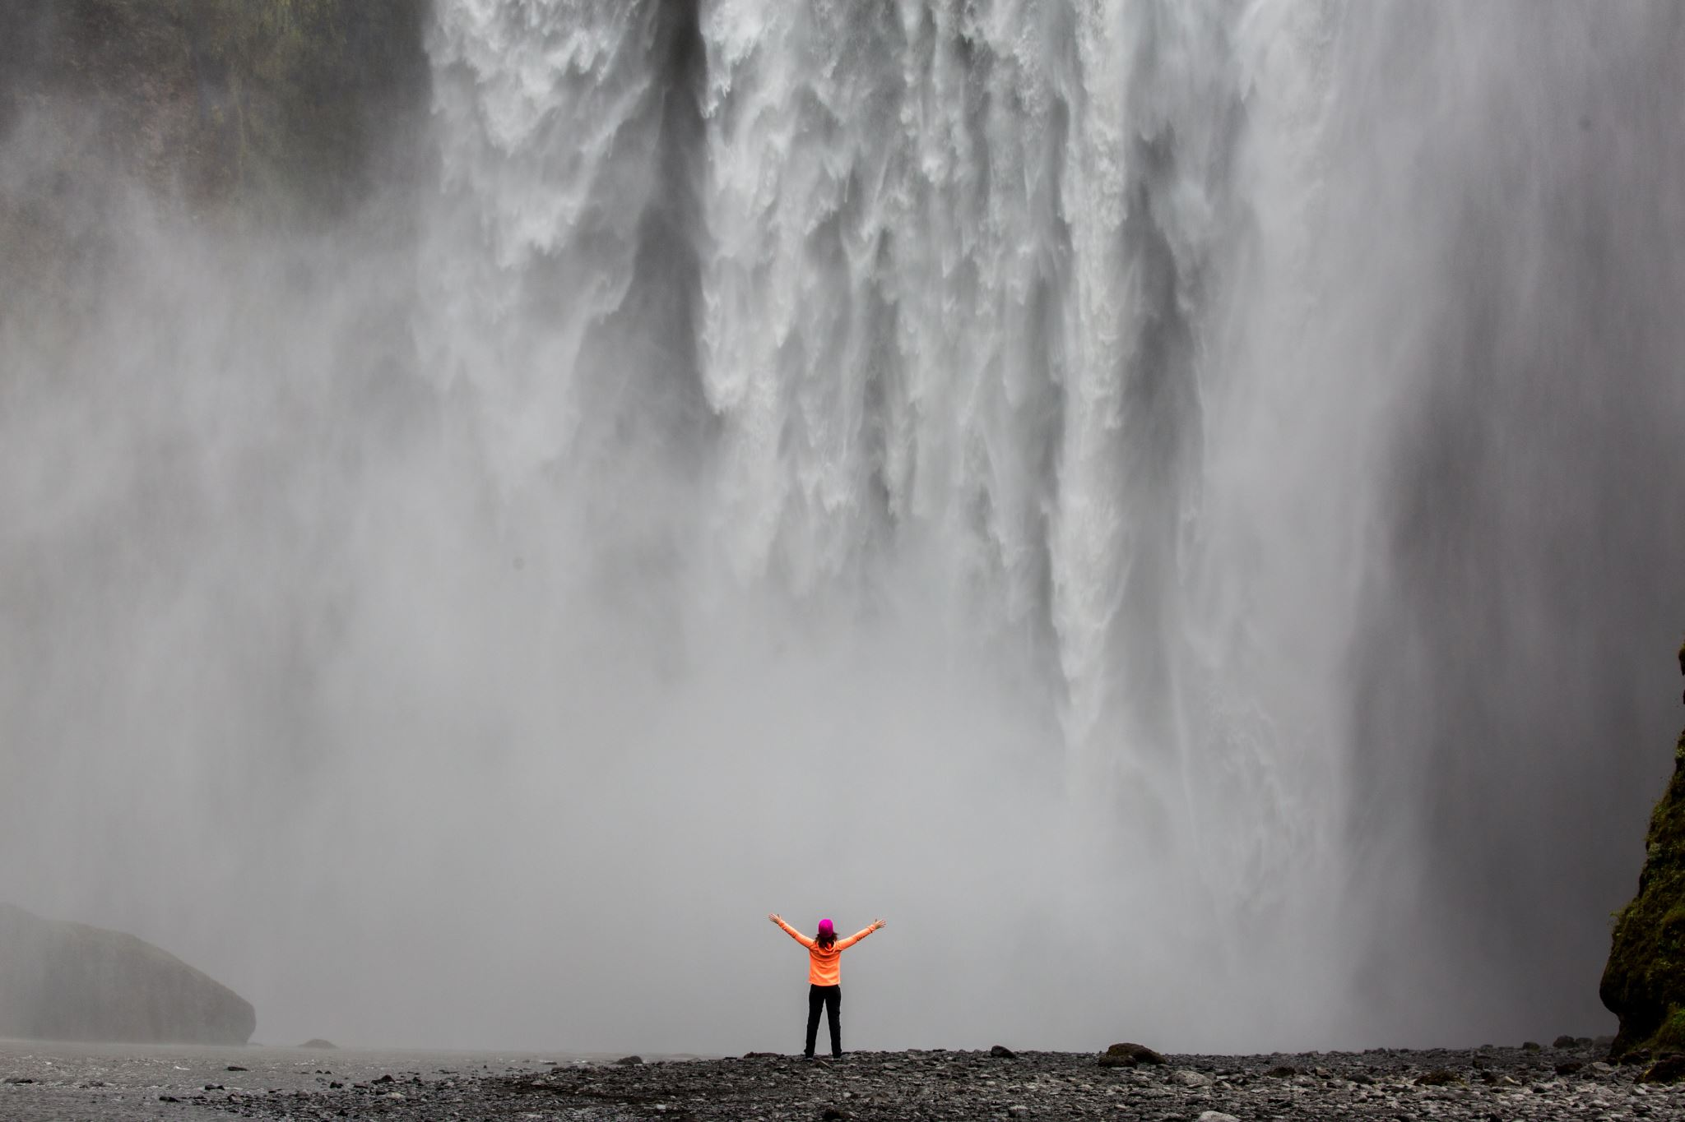

Journal of
Forensic Sciences
SUBMIT YOUR RESEARCH TODAY!

Slide 2

DID you know THAT in 2022…
The Average Days From Manuscript Submission to First Decision was 29 Days
The Average Days From Original Submission to Final Decision was 44 Days

Slide 3
DID you know THAT in 2022…
The Average Turnaround Time From Manuscript Acceptance to Online Early View Publication was 18 Days
(a 38% improvement)
The JFS Impact Factor was
1.717

Slide 4
JOURNAL OF FORENSIC SCIENCES
DID you know THAT in 2022…
Number of Manuscripts Received was 801
Total Reviewers Used for Peer Review was 514

Slide 5
JOURNAL OF FORENSIC SCIENCES
DID you know THAT in 2022…
Total Pages Published in 2022 JFS Issues
2,504
Rejection Rate was
62.7%

Slide 6
DID you know THAT in 2022…
Online Metrics (1.01.22 – 12.31.22)
PDF Article Downloads
696,110
Continued Growth in Institutions With Access to JFS, Subscriptions Increasing by
44.5%
Since 2016

Slide 7
DID you know THAT in 2022…
JFS Received Papers From 58 Countries
The Percentage of Papers Received From the U.S. was 22%

Slide 8


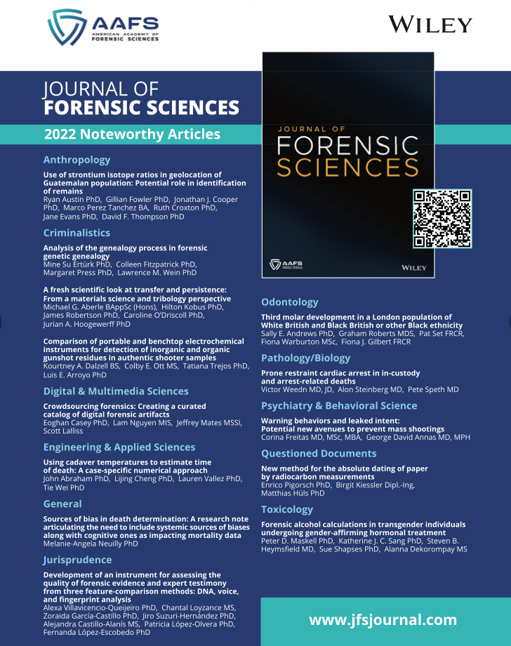
JFS 2022 Noteworthy Articles
This collection of articles will be available
via free access for the months of
February and March 2023.
Look for the display boards in the AAFS 2023 Registration Area and AAFS Pavilion to utilize the QR Code
and download the JFS articles.

Slide 9

                JFS Launched a Forensic Lab Talks
Virt Virtual Seminar Series in 2022
                in partnership with Wiley.
The global reach has been wide, increasing
the visibility of both JFS and AAFS.
JFS Forensic Lab Talks Virtual Seminars To-Date
FLT # | Speaker | Title | Registration Total
FLT #1 | Edward Sisco PhD | Collaborative Research to Address Seized Drug Challenges | 1,056
FLT #2 | Skip Palenik BS | An Introduction to the Forensic Investigation and Analysis of of Trace Evidence | 768
FLT #3 | Jarrad Wagner PhD | Clandestine Synthesis of Methamphetamine: An Overview | 2,180

Slide 10
JFS Mission Statement
To advance forensic science research, education,
and practice by publishing peer-reviewed articles
of the highest quality and impact.
Increase the Visibility of Your Research
Submit Your Manuscript to the Journal of Forensic Sciences
www.jfsjournal.com

