Slide 1


Journal of
Forensic Sciences
SUBMIT YOUR RESEARCH TODAY

Slide 2

HAVE YOU HEARD THAT in 2025…
The Average Days From Submission to First Decision was 37 Days
The Average Days From Submission to Final Decision was 50 Days

Slide 3
Have you heard THAT in 2025…
The Average Turnaround Time From Manuscript Acceptance to Online Early View Publication was 16 Days
(with online publication occurring as early as 6 days from manuscript acceptance)
The JFS Impact Factor was
1.8
(a 20% increase over 2024)
NOTE: The Web of Science has transitioned
to a single digit metric.

Slide 4
JOURNAL OF FORENSIC SCIENCES
Have you heard THAT in 2025…
Number of Original Manuscripts Received was 1,151
(a 21% increase over 2024)
Total Reviewers Used for Peer Review were 675
(a 19% increase over 2024)

Slide 5
JOURNAL OF FORENSIC SCIENCES
Have you heard THAT in 2025…
Total Pages Published in 2025 JFS Issues
2,617
(an 11% increase over 2024)
Rejection Rate was
60.4%

Slide 6
Have you heard THAT in 2025…
Online Metrics (1.01.25– 12.31.25)
Full Text Reads
855,900
(an 8% readership growth over 2024)
Total Articles
Published were
260
(a 16% increase over 2024)

Slide 7
Have you heard THAT in 2025…
JFS Received Papers From 67 Countries
The Percentage of Papers Received From the U.S. was 18%

Slide 8
Have you heard THAT in 2025…
JFS Compiled a Virtual Issue on
Invisible Killers, Inevitable Traces: Innovations in Forensic Toxicology from Around the World
JFS Published a Special Section on Vicarious Trauma in Forensic Scientists (In the JFS January 2026 Issue)

Slide 9


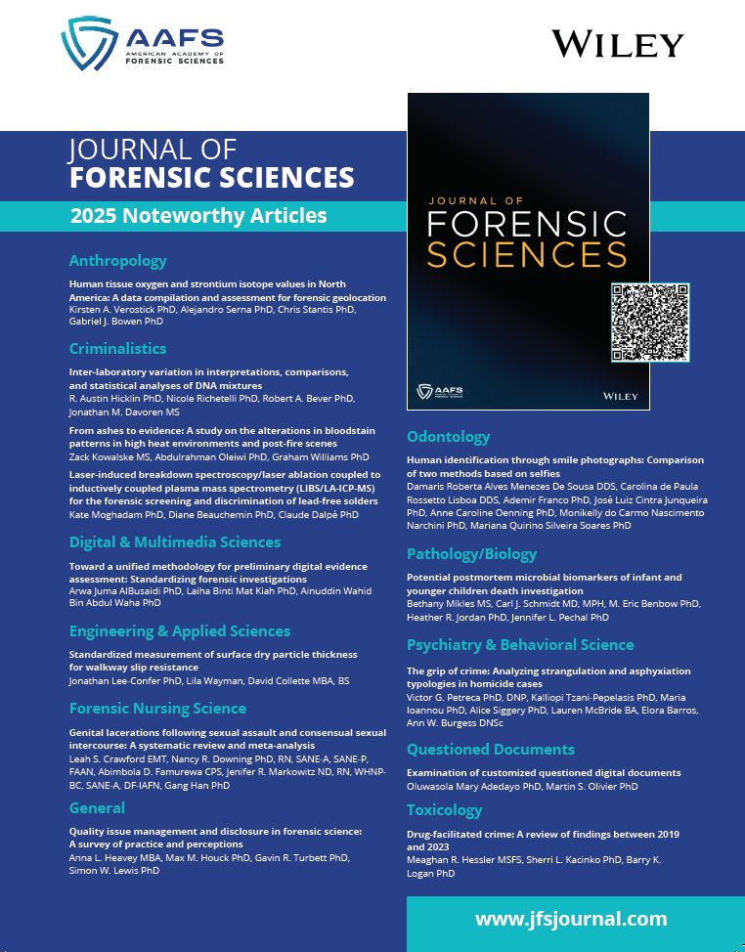
JFS 2025 Noteworthy Articles
This collection of articles will be available
via free access for the months of
February and March 2026.
Look for the display boards in the AAFS 2026 Registration Area and AAFS Pavilion to utilize the QR Code
and download the JFS articles.

Slide 10

                JFS Continued its Forensic Lab Talks
Virt Virtual Seminar Series
                in partnership with Wiley.
The global reach has been wide, increasing
the visibility of both JFS and AAFS.
JFS Forensic Lab Talks Virtual Seminars Offered in 2025
 | Speaker | Title | Registration Total
FLT #8 | Georgina Sauzier PhD | LipSynch Battle: Synchrotron Spectroscopic Imaging for the Study of Forensic Cosmetic Traces | 546
FLT #9 | Susan Walsh PhD | Phenotyping of Externally Visible Characteristics | 1,536

Slide 11
JFS Mission Statement
To advance forensic science research, education,
and practice by publishing peer-reviewed articles
of the highest quality and impact.
Increase the Visibility of Your Research
Submit Your Manuscript to the Journal of Forensic Sciences
www.jfsjournal.com

